Slide 1
Data Structures
Sorting Technique – Insertion Sort

Slide 2
Introduction

Slide 3
Data Structure – Sorting Techniques
Introduction
Insertion Sort:
It is a simple sorting algorithm that builds the final sorted array(or list )
one item at a time

Slide 4
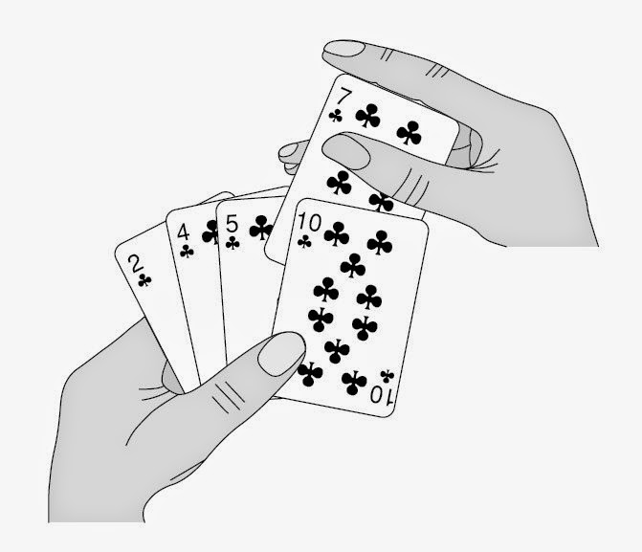
Data Structure – Sorting Techniques
Introduction
Insertion Sort:
It is a simple sorting algorithm that builds the final sorted array(or list )
one item at a time
It is an in-place comparison-based algorithm

Slide 5
Data Structure – Sorting Techniques
Insertion Sort
arr[SIZE]
SIZE = 5
arr[0]
arr[1]
arr[2]
arr[3]
arr[4]

Slide 6
Data Structure – Sorting Techniques
Insertion Sort
arr[SIZE]
SIZE = 5
23
78
45
8
32
arr[0]
arr[1]
arr[2]
arr[3]
arr[4]

Slide 7
Data Structure – Sorting Techniques
Insertion Sort
arr[SIZE]
SIZE = 5
Sort
Unsorted
23
78
45
8
32
arr[0]
arr[1]
arr[2]
arr[3]
arr[4]

Slide 8
Data Structure – Sorting Techniques
Insertion Sort
arr[SIZE]
SIZE = 5
key=78
Sort
Unsorted
23
78
45
8
32
arr[0]
arr[1]
arr[2]
arr[3]
arr[4]

Slide 9
Data Structure – Sorting Techniques
Insertion Sort
arr[SIZE]
SIZE = 5
key=78
key < arr[0]
Sort
Unsorted
23
78
45
8
32
78 < 23
arr[0]
arr[1]
arr[2]
arr[3]
arr[4]

Slide 10
Data Structure – Sorting Techniques
Insertion Sort
arr[SIZE]
SIZE = 5
key=78
key < arr[0]
Sort
Unsorted
23
78
45
8
32
78 < 23
arr[0]
arr[1]
arr[2]
arr[3]
arr[4]

Slide 11
Data Structure – Sorting Techniques
Insertion Sort
arr[SIZE]
SIZE = 5
key=45
key < arr[1]
Sort
Unsorted
23
78
45
8
32
45 < 78
arr[0]
arr[1]
arr[2]
arr[3]
arr[4]

Slide 12
Data Structure – Sorting Techniques
Insertion Sort
arr[SIZE]
SIZE = 5
key=45
key < arr[1]
Sort
Unsorted
23
78
45
8
32
45 < 78
arr[0]
arr[1]
arr[2]
arr[3]
arr[4]

Slide 13
Data Structure – Sorting Techniques
Insertion Sort
arr[SIZE]
SIZE = 5
key=45
key < arr[1]
Sort
Unsorted
23
78
8
32
45 < 78
arr[0]
arr[1]
arr[2]
arr[3]
arr[4]

Slide 14
Data Structure – Sorting Techniques
Insertion Sort
arr[SIZE]
SIZE = 5
key=45
key < arr[1]
key < arr[0]
Sort
Unsorted
23
78
8
32
45 < 78
45 < 23
arr[0]
arr[1]
arr[2]
arr[3]
arr[4]

Slide 15
Data Structure – Sorting Techniques
Insertion Sort
arr[SIZE]
SIZE = 5
key=45
key < arr[1]
key < arr[0]
Sort
Unsorted
23
45
78
8
32
45 < 78
45 < 23
arr[0]
arr[1]
arr[2]
arr[3]
arr[4]

Slide 16
Data Structure – Sorting Techniques
Insertion Sort
arr[SIZE]
SIZE = 5
key=45
Sort
Unsorted
23
45
78
8
32
arr[0]
arr[1]
arr[2]
arr[3]
arr[4]

Slide 17
Data Structure – Sorting Techniques
Insertion Sort
arr[SIZE]
SIZE = 5
key= 8
Sort
Unsorted
key < arr[2]
23
45
78
8
32
8 < 78
arr[0]
arr[1]
arr[2]
arr[3]
arr[4]

Slide 18
Data Structure – Sorting Techniques
Insertion Sort
arr[SIZE]
SIZE = 5
key= 8
Sort
Unsorted
key < arr[2]
23
45
78
8
32
8 < 78
arr[0]
arr[1]
arr[2]
arr[3]
arr[4]

Slide 19
Data Structure – Sorting Techniques
Insertion Sort
arr[SIZE]
SIZE = 5
key= 8
Sort
Unsorted
key < arr[2]
key < arr[1]
23
45
78
32
8 < 78
8 < 45
arr[0]
arr[1]
arr[2]
arr[3]
arr[4]

Slide 20
Data Structure – Sorting Techniques
Insertion Sort
arr[SIZE]
SIZE = 5
key= 8
Sort
Unsorted
key < arr[2]
key < arr[1]
23
45
78
32
8 < 78
8 < 45
arr[0]
arr[1]
arr[2]
arr[3]
arr[4]

Slide 21
Data Structure – Sorting Techniques
Insertion Sort
arr[SIZE]
SIZE = 5
key= 8
Sort
Unsorted
key < arr[2]
key < arr[1]
23
45
78
32
8 < 78
8 < 45
arr[0]
arr[1]
arr[2]
arr[3]
arr[4]

Slide 22
Data Structure – Sorting Techniques
Insertion Sort
arr[SIZE]
SIZE = 5
key= 8
Sort
Unsorted
key < arr[2]
key < arr[1]
key < arr[0]
23
45
78
32
8 < 78
8 < 45
8 < 23
arr[0]
arr[1]
arr[2]
arr[3]
arr[4]

Slide 23
Data Structure – Sorting Techniques
Insertion Sort
arr[SIZE]
SIZE = 5
key= 8
Sort
Unsorted
key < arr[2]
key < arr[1]
key < arr[0]
23
45
78
32
8 < 78
8 < 45
8 < 23
arr[0]
arr[1]
arr[2]
arr[3]
arr[4]

Slide 24
Data Structure – Sorting Techniques
Insertion Sort
arr[SIZE]
SIZE = 5
key= 8
Sort
Unsorted
key < arr[2]
key < arr[1]
key < arr[0]
23
45
78
32
8 < 78
8 < 45
8 < 23
arr[0]
arr[1]
arr[2]
arr[3]
arr[4]

Slide 25
Data Structure – Sorting Techniques
Insertion Sort
arr[SIZE]
SIZE = 5
key= 8
Sort
Unsorted
key < arr[2]
key < arr[1]
key < arr[0]
8
23
45
78
32
8 < 78
8 < 45
8 < 23
arr[0]
arr[1]
arr[2]
arr[3]
arr[4]

Slide 26
Data Structure – Sorting Techniques
Insertion Sort
arr[SIZE]
SIZE = 5
key= 8
Sort
Unsorted
key < arr[2]
key < arr[1]
key < arr[0]
8
23
45
78
32
8 < 78
8 < 45
8 < 23
arr[0]
arr[1]
arr[2]
arr[3]
arr[4]

Slide 27
Data Structure – Sorting Techniques
Insertion Sort
arr[SIZE]
SIZE = 5
key=32
Sort
Unsorted
8
23
45
78
32
arr[0]
arr[1]
arr[2]
arr[3]
arr[4]

Slide 28
Data Structure – Sorting Techniques
Insertion Sort
arr[SIZE]
SIZE = 5
key=32
Sort
Unsorted
key < arr[3]
8
23
45
78
32
32 < 78
arr[0]
arr[1]
arr[2]
arr[3]
arr[4]

Slide 29
Data Structure – Sorting Techniques
Insertion Sort
arr[SIZE]
SIZE = 5
key=32
Unsorted
Sort
key < arr[3]
8
23
45
78
32
32 < 78
arr[0]
arr[1]
arr[2]
arr[3]
arr[4]

Slide 30
Data Structure – Sorting Techniques
Insertion Sort
arr[SIZE]
SIZE = 5
key=32
Unsorted
Sort
key < arr[3]
8
23
45
78
32 < 78
arr[0]
arr[1]
arr[2]
arr[3]
arr[4]

Slide 31
Data Structure – Sorting Techniques
Insertion Sort
arr[SIZE]
SIZE = 5
key=32
Unsorted
Sort
key < arr[3]
key < arr[2]
8
23
45
78
32 < 78
32 < 45
arr[0]
arr[1]
arr[2]
arr[3]
arr[4]

Slide 32
Data Structure – Sorting Techniques
Insertion Sort
arr[SIZE]
SIZE = 5
key=32
Unsorted
Sort
key < arr[3]
key < arr[2]
8
23
45
78
32 < 78
32 < 45
arr[0]
arr[1]
arr[2]
arr[3]
arr[4]

Slide 33
Data Structure – Sorting Techniques
Insertion Sort
arr[SIZE]
SIZE = 5
key=32
Unsorted
Sort
key < arr[3]
key < arr[2]
8
23
45
78
32 < 78
32 < 45
arr[0]
arr[1]
arr[2]
arr[3]
arr[4]

Slide 34
Data Structure – Sorting Techniques
Insertion Sort
arr[SIZE]
SIZE = 5
key=32
Unsorted
Sort
key < arr[3]
key < arr[2]
key < arr[1]
8
23
45
78
32 < 78
32 < 45
32 < 23
arr[0]
arr[1]
arr[2]
arr[3]
arr[4]

Slide 35
Data Structure – Sorting Techniques
Insertion Sort
arr[SIZE]
SIZE = 5
key=32
Unsorted
Sort
key < arr[3]
key < arr[2]
key < arr[1]
8
23
32
45
78
32 < 78
32 < 45
32 < 23
arr[0]
arr[1]
arr[2]
arr[3]
arr[4]

Slide 36
Data Structure – Sorting Techniques
Insertion Sort
arr[SIZE]
SIZE = 5
key=32
Sort
key < arr[3]
key < arr[2]
key < arr[1]
8
23
32
45
78
32 < 78
32 < 45
32 < 23
arr[0]
arr[1]
arr[2]
arr[3]
arr[4]

Slide 37
Data Structure – Sorting Techniques
Algorithm
Insertion Sort(arr,size)
for i = 1 upto size
key = arr[i]
j = i - 1
while ( j >=0 AND arr[j] > key)
arr[j+1] = arr[j]
j = j - 1
arr[j+1] = key
return e_true

Slide 38
Data Structure – Sorting Techniques
Insertion Sort
Advantages
It exhibits a good performance when dealing with a small list.
The insertion sort is an in-place sorting algorithm so the space requirement
is minimal..

Slide 39
Data Structure – Sorting Techniques
Insertion Sort
Advantages
It exhibits a good performance when dealing with a small list.
The insertion sort is an in-place sorting algorithm so the space requirement
is minimal..
Disadvantages
It requires n-squared processing steps for every n number of elements to be sorted.
Time complexity = O(n²)

Slide 40
Code - Insertion Sort

